Slide 1


CHILD
FIND
Locate, Identify, Evaluate
2026-2027

Slide 2
AGENDA
01
What is Child Find?
04
What are the LEAs Responsibilities?
02
Who is Covered?
05
Reminders
03
Who Can Initiate a Referral?
06
Resources

Slide 3

What is Child Find?
Child Find is the affirmative and ongoing process of public awareness, coordination with agencies and primary sources, and screening procedures to locate, identify, and evaluate all children with disabilities from birth through age 21 who may require early intervention or special education services.

Slide 4
What is Child Find?
It’s the Law!
Federal State
42 USC 11434a Texas Education Code
34 CFR Part 300 Texas Government Code
19 TAC Chapter 89

Slide 5
What is Child Find?
Child Find refers to the federal requirement under the Individuals with Disabilities Education Act (IDEA) that all children in need of special education services are identified, located, and evaluated. Schools are responsible for conducting Child Find and identifying all IDEA-eligible students that reside in their jurisdiction. Child Find is not a passive activity, but rather an active process.

Slide 6
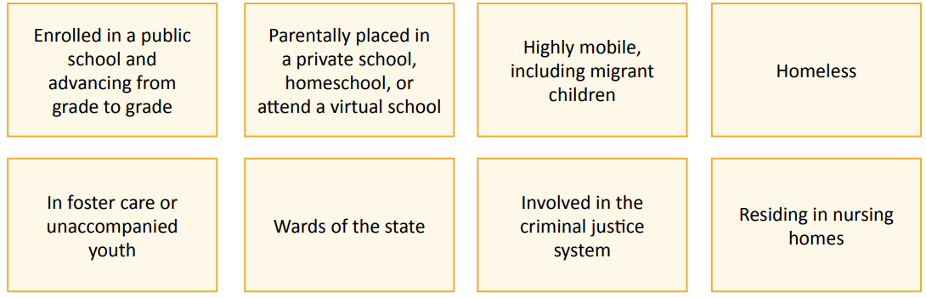
Who is Covered?
Children with disabilities from birth through age 21 who may require early intervention or special education services.

Slide 7
Who is Covered?
MISD provides special education and related services to eligible students ages 3 through 21 who reside within McAllen or MISD’s jurisdiction.
To be eligible, a student must:
(a) have one or more of the thirteen qualifying disabilities
(b) need special education and related services - Specially Designed Instruction - because of the disability
MISD also services students from birth through age 21 who have a Visual Impairment or are Deaf or Hard of Hearing.

Slide 8
Autism
Deaf-Blind
Deaf or Hard of Hearing
*Developmental Delay
Emotional Disability
Intellectual Disability
Multiple Disabilities
Orthopedic Impairment
Other Health Impairment
Specific Learning Disability
Speech or Language Impairment
Traumatic Brain Injury
Visual Impairment
Who is Covered?
13 ELIGIBILITIES
*The previously utilized Non-Categorical Early Childhood (NCEC) category is being phased out

Slide 9
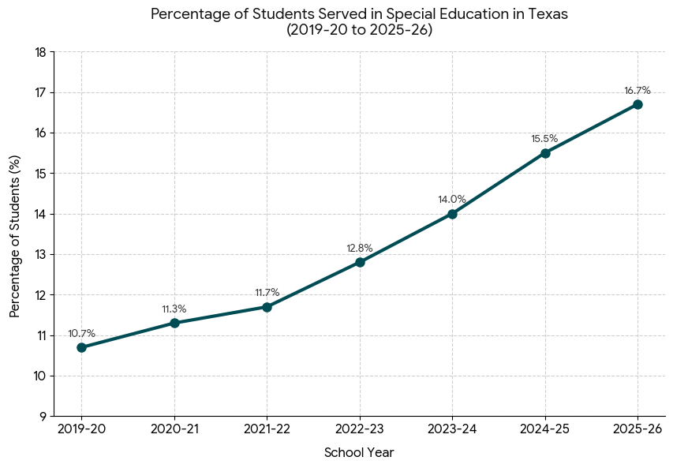
Students Served in Special Education (TX)
During the 2019-2020 school year, special education students represented 10.7% of the total student population in Texas.
As of the 2025-2026 school year, the percentage has increased to 15.5% of the total student population.
The total numbers served has increased from 588, 820 to 903,072
TEA: Source data from a. Speced_dis_student24f by unique student id total is and Windham submission. Dataset was collected as Enrollment in Oct Fall, 2025. TE

Slide 10
Who can Initiate a Referral?
School Personnel
Student’s Parent or Legal Guardian
Another Person Involved in the Education or Care of the Student (e.g., relative, doctor)
*Even if the student is progressing from grade to grade
*Referral may be made verbally or in writing
*By law, the district must seriously consider all requests (referral committee)
ANYONE

Slide 11
MISD Special
Education Department
Vanessa Rogers,
Social Worker
Noel Ramos, Social Worker
956-632-3285
Who can Initiate a Referral?
Child Find requires school districts to have a PROCESS for identifying and evaluating children who may need special education and related services, such as counseling or occupational therapy.
Even infants and toddlers can be evaluated and potentially receive services through early childhood intervention programs.
Parents whose children do not attend public schools may not know what kind of help is available; therefore, MISD will use various outreach efforts to notify all parents.
Note

Slide 12
MISD Special
Education Department
Vanessa Rogers,
Social Worker
Noel Ramos, Social Worker
956-632-3285
Who can Initiate a Referral?
For school aged children, a parent may verbally request or provide a written letter to the district’s director of special education services or to a district administrative employee, such as a campus principal. If the request is made in writing, the district is obliged to respond within 15 school days from the date the request is received.
For non-school aged children, a parent may request an evaluation by calling or providing a written request to the MISD Special Education Department .
Note

Slide 13
Who can Initiate a Referral?
MTSS
Multi-Tiered
System of Support
504 Student Services Plan
Students who are struggling in the general education classroom should be considered for support services (e.g., tutorial, compensatory, response to intervention, other academic or behavioral support services provided through MTSS) and potentially referred for a special education evaluation under IDEA in addition to receiving support services. Support services can continue during an evaluation.
Early intervention and identification can prevent failure and frustration.

Slide 14
What are the LEAs Responsibilities?
The Local Education Agency (LEA) must develop a child find process which includes the following responsibilities:

Slide 15
What are the LEAs Responsibilities?
1
Develop written local policies and operating procedures.

Slide 16
What are the LEAs Responsibilities?
2
Engage in public and parent/guardian awareness activities, including partnering with primary referral sources.
*At the time of a student’s placement in the disciplinary alternative education program (DAEP), information regarding Child Find will be provided to the student’s parent or guardian.

Slide 17
What are the LEAs Responsibilities?
3
Notify parents by providing the Right to Information Statement annually.
MISD Website MISD Student Code of Conduct MISD Student Handbook

Slide 18
MISD Website MISD Student Code of Conduct MISD Student Handbook
What are the LEAs Responsibilities?
4
Conduct school-wide screenings.
MAP Testing K & 1st Dyslexia Screeners IReady Circle

Slide 19
What are the LEAs Responsibilities?
5
Ensure appropriate and timely referrals for evaluation.
15 school days, from date of parent request, to initiate or refuse request
45 school days, from date of consent, to complete a Full and Individual Initial Evaluation
30 calendar days, from date of FIIE, to present FIIE results to ARDC

Slide 20



What are the LEAs Responsibilities?
6
Coordinate with other agencies, including Early Childhood Intervention (ECI).

Slide 21
What are the LEAs Responsibilities?
7
Maintain and report accurate data.
State Performance Plan Indicator (SPPI) 11 - ages 3-21
State Performance Plan Indicator (SPPI) 12 - prior to age 3

Slide 22
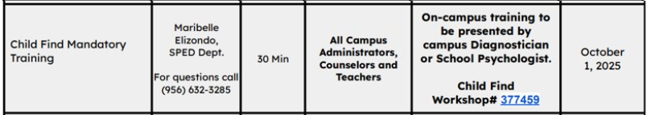
What are the LEAs Responsibilities?
8
Provide training and professional development to all staff.

Slide 23
Reminders
Child Find is not a passive process. LEAs should not wait for others to refer students for special education services. LEAs must seek out Individuals with Disabilities Education Act (IDEA) eligible students.

Slide 24
Reminders
A public awareness campaign should target a wide variety of people who may work with the student, such as parents/families, daycares, summer camps, physicians and medical clinics, and religious institutions.

Slide 25
Reminders
Referrals for an initial evaluation should not be delayed or denied because pre-referral interventions have not been implemented with a student. If there is a basis to suspect a student has a disability and needs special education related services based on this disability, the student must be referred for an evaluation.

Slide 26
Reminders
Parents must be notified annually of the options and requirements for assisting students who may need special education services. The notice includes the rights of a child and the general process available to initiate a referral.

Slide 27
Conclusion
Who is Covered?
Child Find covers every child from birth through age 21. Eligibility = qualifying disability and need for services
Child Find is a legal requirement that Local Education Agencies (LEAs) find all children who have disabilities and who may be entitled to special education services.
Who Can Initiate a Referral?
-School Personnel
-Student’s Parent or Legal Guardian
-Another Person Involved in the Education or Care of the Student
Locate
Identify
Evaluate
What are the LEAs Responsibilities?
Policies/procedures, public awareness, notification of parents, school-wide screening, appropriate and timely referrals, coordination with other agencies, data collection, training

Slide 28
Resources
Child Find Duty Quick Guide
https://spedsupport.tea.texas.gov/sites/default/files/2023-08/child-find-duty-quick-guide.pdf
Texas Education Agency (TEA) Timely Initial Evaluation (Child Find)
https://tea.texas.gov/special-populations-and-support/special-education/data-and-reports/timely-initial-evaluation-child-find
Texas Legal Framework: Child Find Duty
https://fw.escapps.net/node/3895
LINK
LINK
LINK

Slide 29
Executive Director Special Education:
Ms. Maribelle Elizondo
Director for Regional Day School Program for the Deaf:
Ms. Liza Lara
Special Education Supervisors:
Ms. Karla Barnett , Ms. Jacquelin Espinosa, Ms. Jessica Garza, Ms. Rachael Montgomery
Social Workers:
Ms. Vanessa Rogers vanessa.rogers@mcallenisd.net
Mr. Noel Ramos NOEL.RAMOS@mcallenisd.net
Special Education Department
2100 W. Hackberry Avenue
McAllen, TX 78501
P: 956-632-3285
F: 956-632-3269

Slide 30
THANK YOU
QUESTIONS?

